Slide 1



Breaking the ice with Pester for PowerShell tinkerers
- Adam Cook (@codaamok)
Notes:
Show you:
Bare minimum you need to know in order to start using and benefit from Pester
Won’t cover every detail and possible usage

Slide 2
Agenda
Pipeline
What it is, why, and how does Pester fit in?
Pester
Intro, discussion, and demos
Real world example of using Pester in CI/CD pipeline

Slide 3
What do I need?
PowerShell experience
Just enough to be dangerous ☺
Some experience with Git
Not essential
Curiosity!

Slide 4
Pipeline

Slide 5
First look at Pester
History
Came with Windows
Update it to get v5
Start with v5
Maintainer shout out

Slide 6
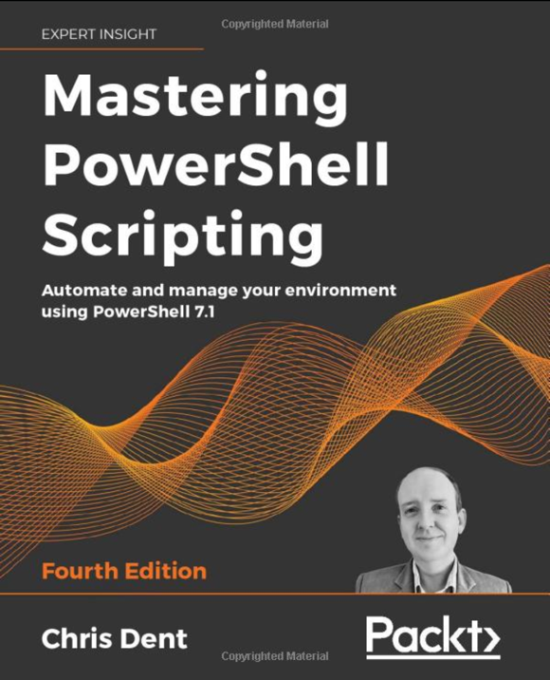
More learning
Docs
https://pester-docs.netlify.app
YouTube playlist:
https://acook.io/pester
Mastering PowerShell Scripting - Chris Dent
https://www.amazon.co.uk/Mastering-PowerShell-Scripting-Automate-environment/dp/1800206542

